Slide 1
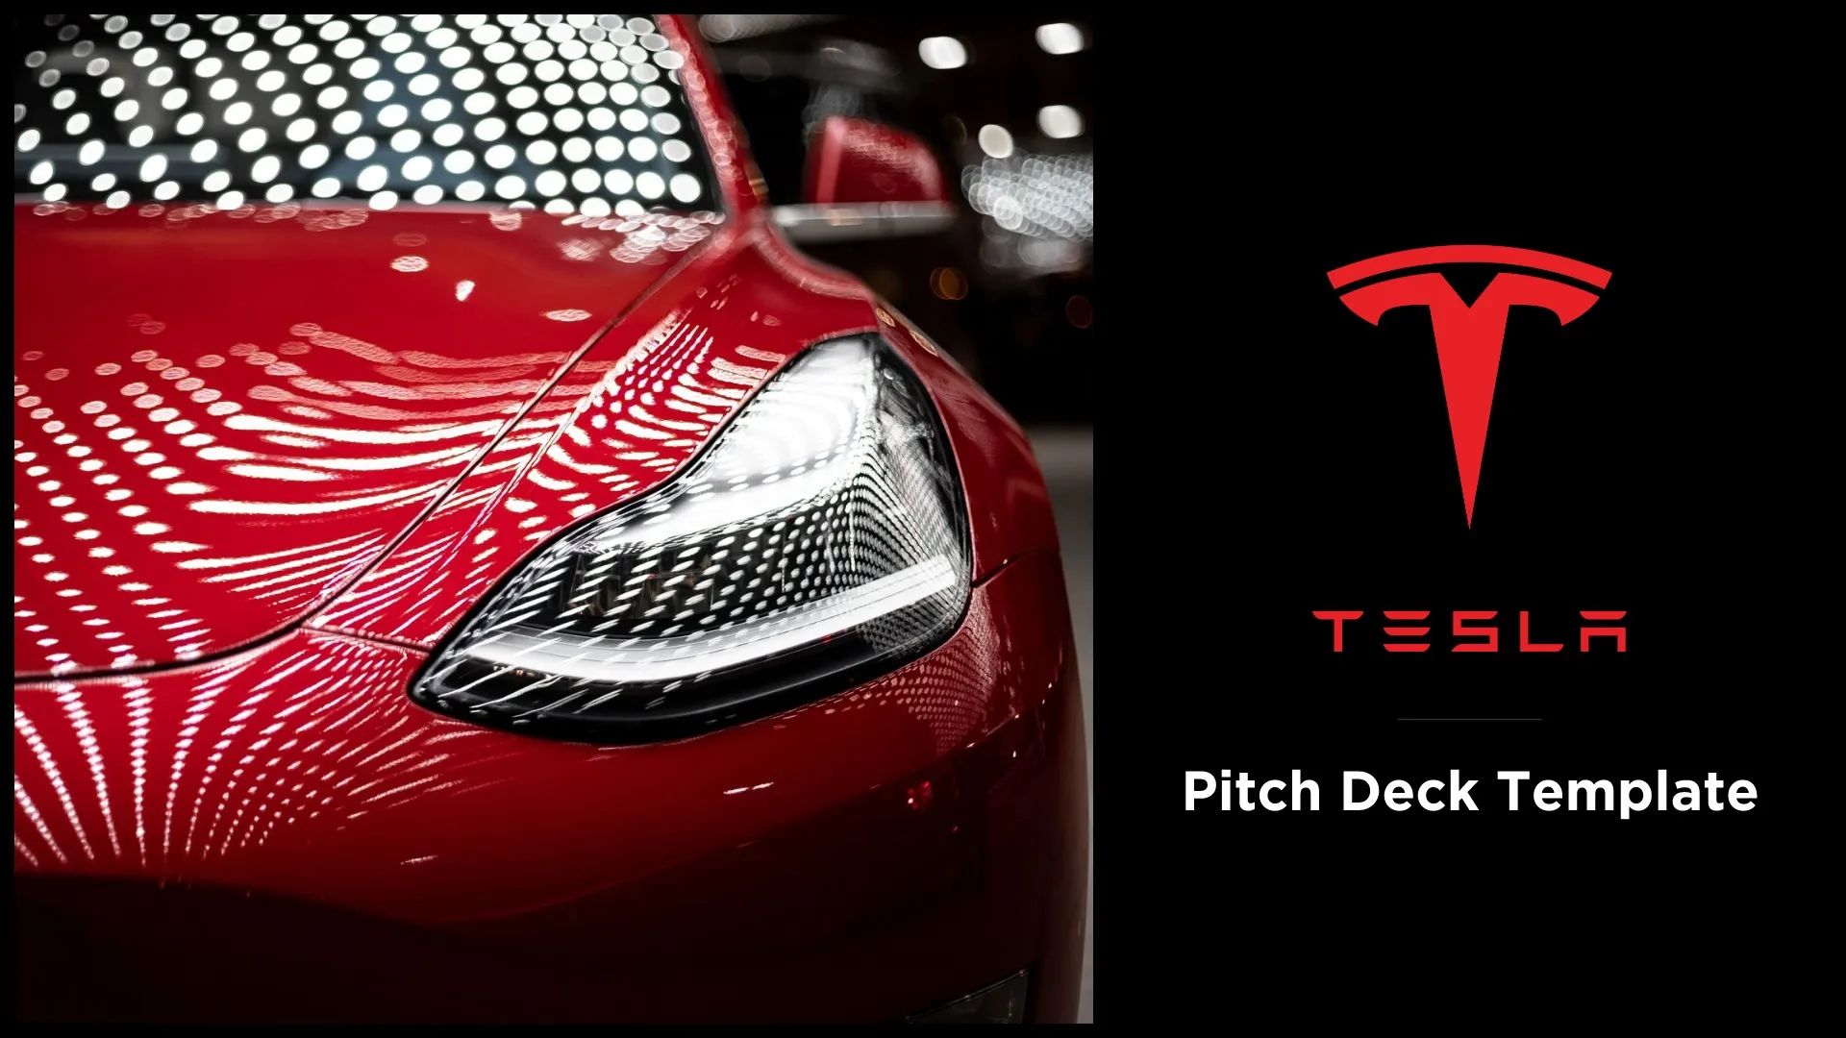

Tesla's Autopilot: A Critical Look at its Formation, Components, Challenges and Future Directions
MUKHESH RAVI

Slide 2
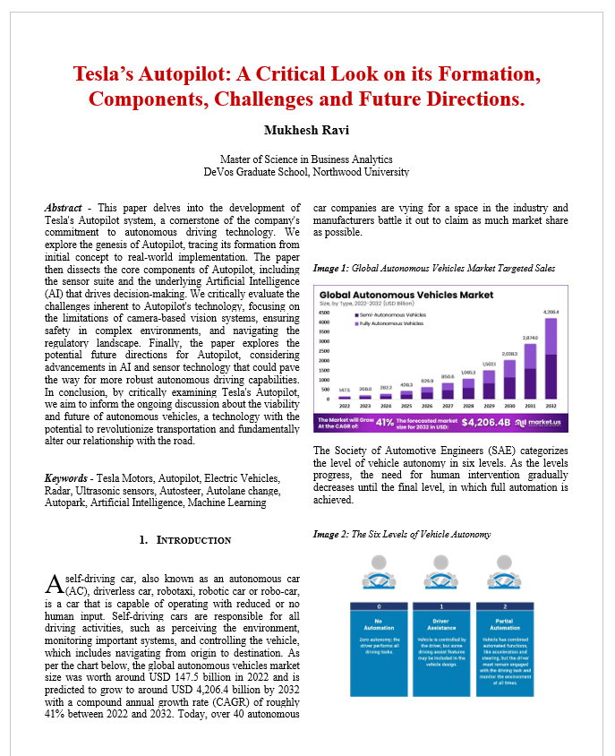
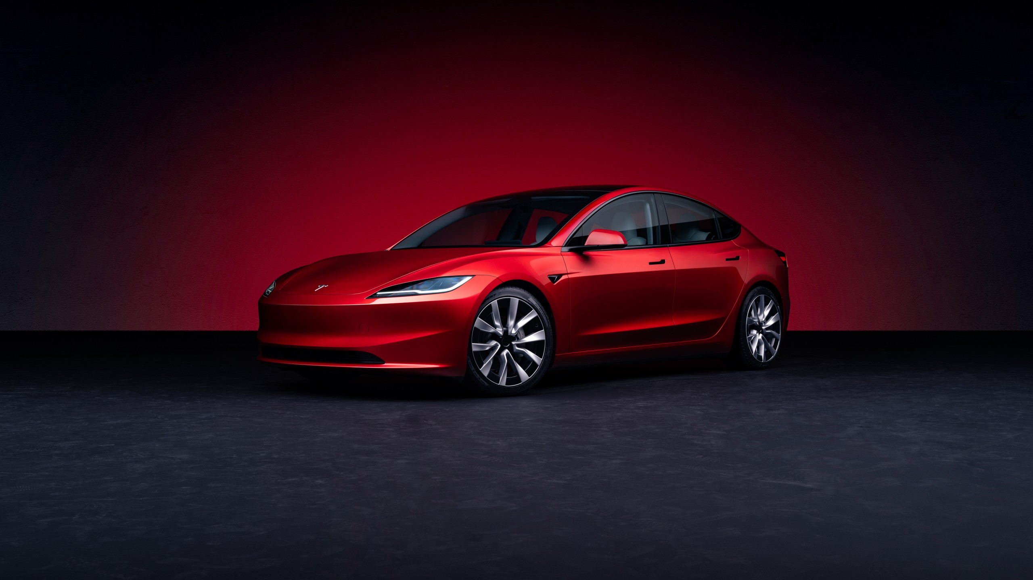
The Research Paper
Introduction
Modules of Tesla’s Autopilot
Features of Tesla’s Autopilot
Challenges
SWOT Analysis
Literature Review
Conclusion
Recommendations
Notes:
Modules – Camera, radars, sensors, GPS

Slide 3
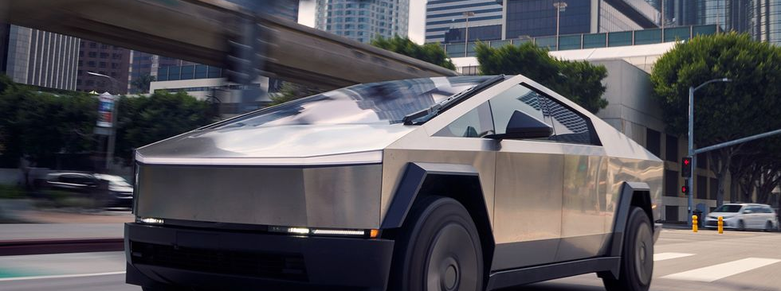
Problem Statement
Tesla aims to create more sustainable vehicles by developing electric cars that reduce carbon emissions and autonomous driving technologies that enhance safety and efficiency. Their goal is to lead the transition towards a greener and smarter transportation future.

Slide 4








Possible Solutions
Enhanced Advanced Driver Assistance Systems (ADAS)
Connected Vehicle Technologies
Infrastructure Improvements
Autopilot System driven by Artificial Intelligence
Notes:
ADAS - pre-set rules couldn't adapt to ever-changing situations like construction zones or unusual traffic patterns.
Connected Vehicle Tech – wanted cars to talk and hear from its surroundings, signs to emit information
Infra. Improvements - Upgrading the entire infrastructure would be incredibly expensive and require cooperation with government agencies, which would be a lengthy process.

Slide 5
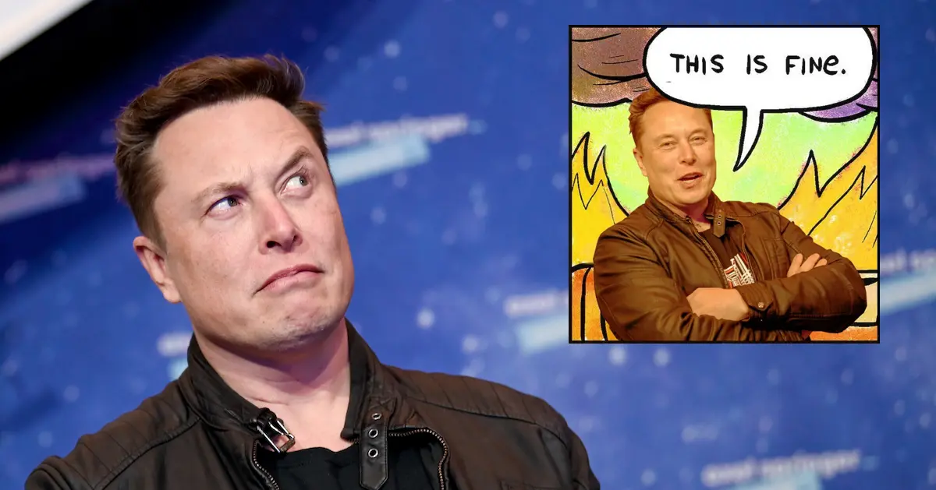
The Decision Making
Advanced Driver Assistant System
Connected Vehicle Technologies
Infrastructure Improvements
Notes:
ADAS - pre-set rules couldn't adapt to ever-changing situations like construction zones or unusual traffic patterns.
Connected Vehicle Tech – wanted cars to talk and hear from its surroundings, signs to emit information
Infra. Improvements - Upgrading the entire infrastructure would be incredibly expensive and require cooperation with government agencies, which would be a lengthy process.

Slide 6
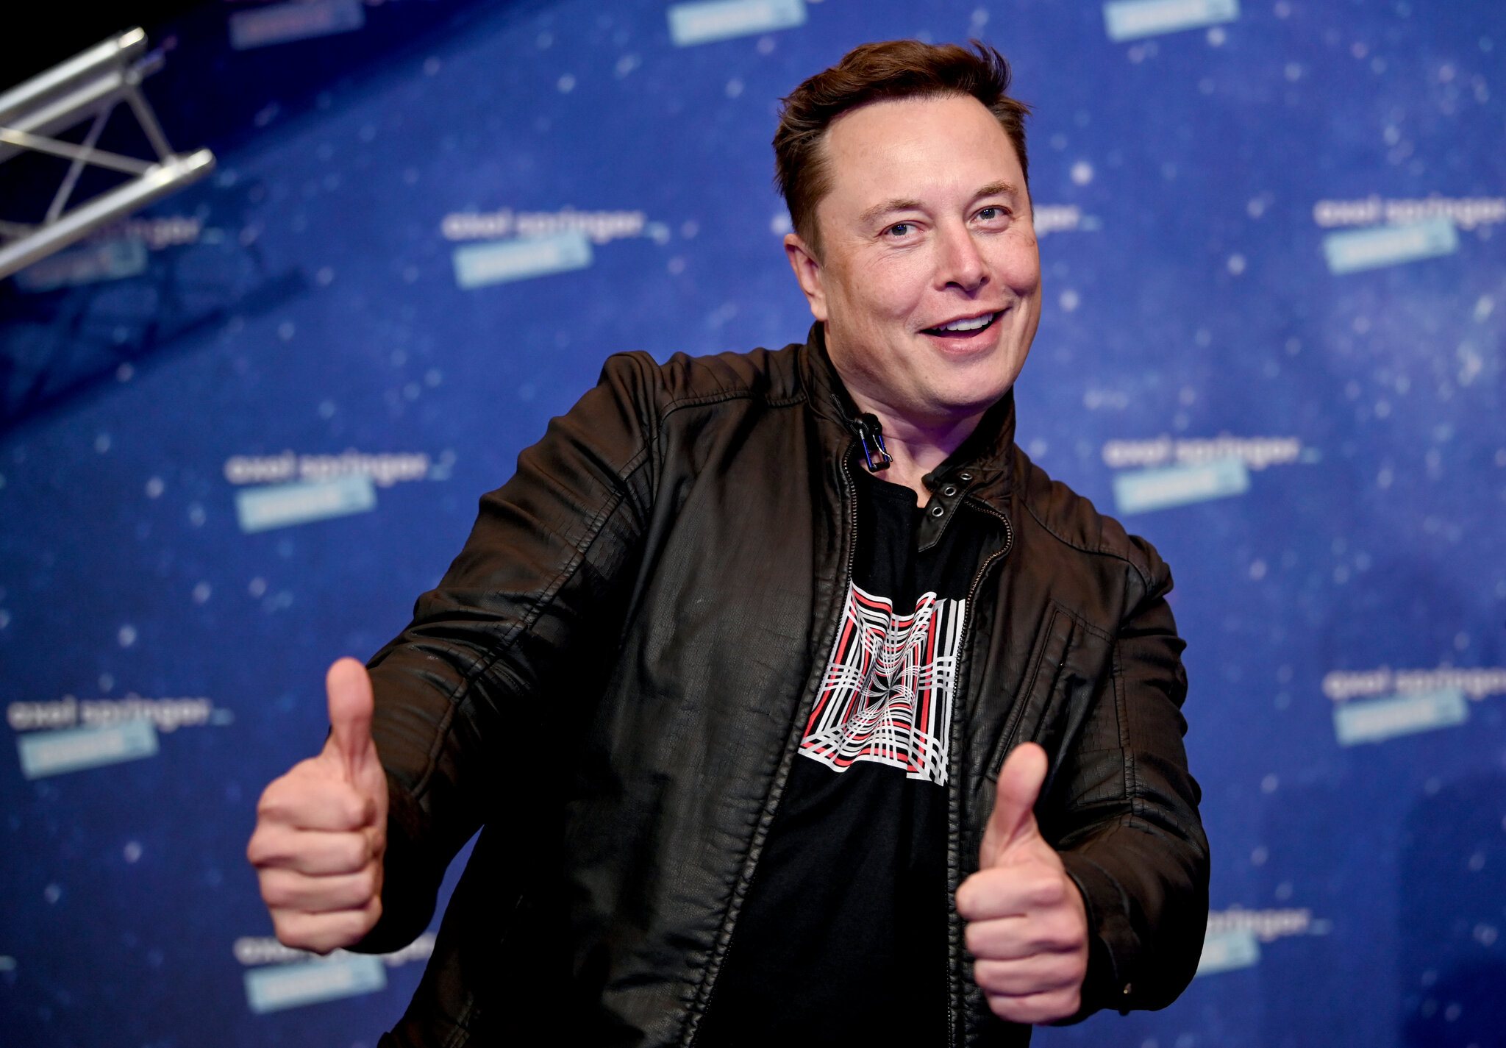
Chosen Decision
Tesla’s Autopilot System driven by Artificial Intelligence
Why?
learn and adapt to new situations on the road
constantly improved and deployed to a large fleet of vehicles
Notes:
learn and adapt to new situations on the road, unlike pre-programmed rules that struggle with the unexpected constantly improved and deployed to a large fleet of vehicles – scalability achieved

Slide 7
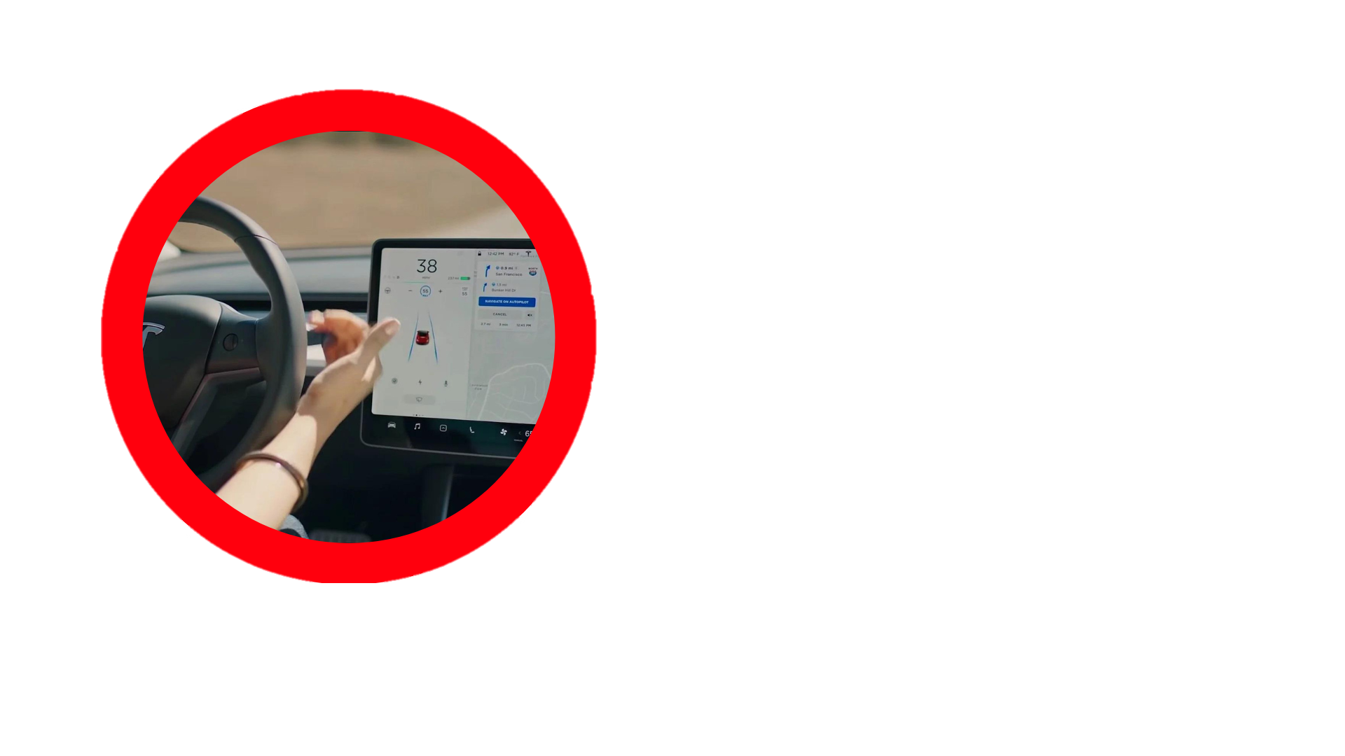
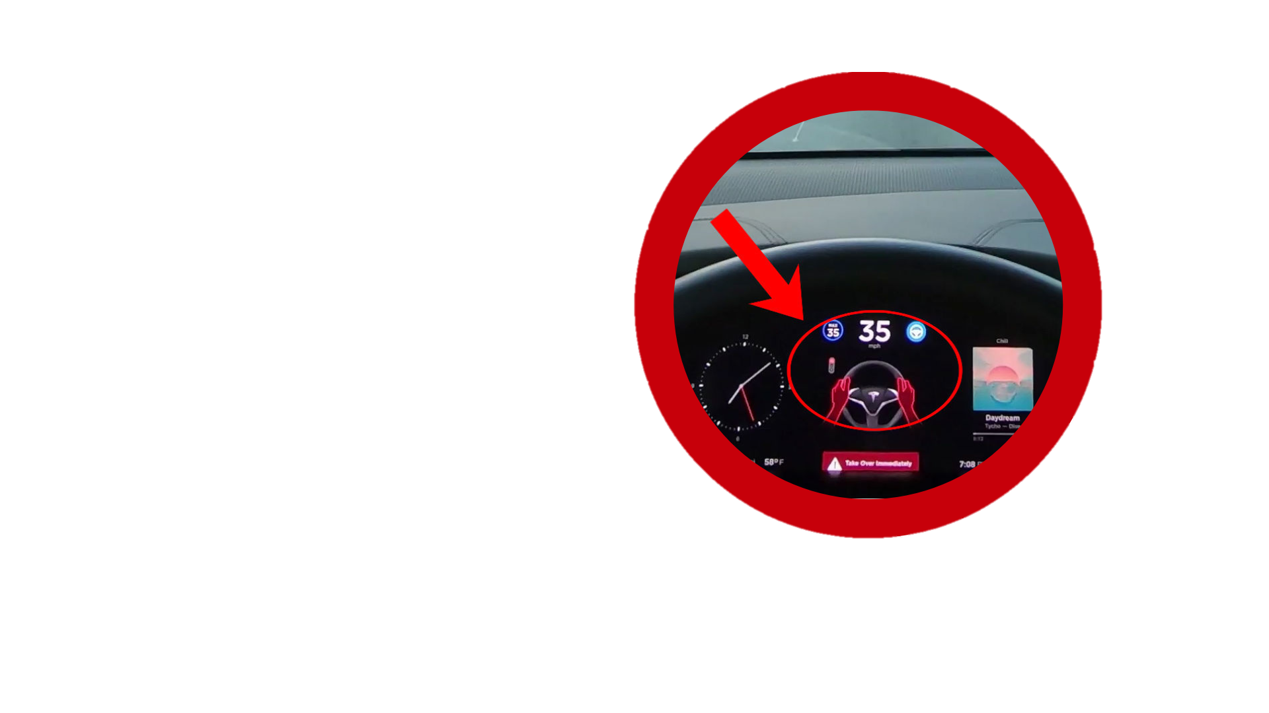
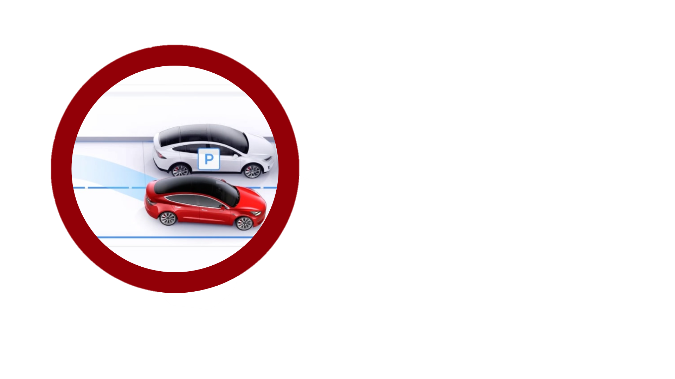
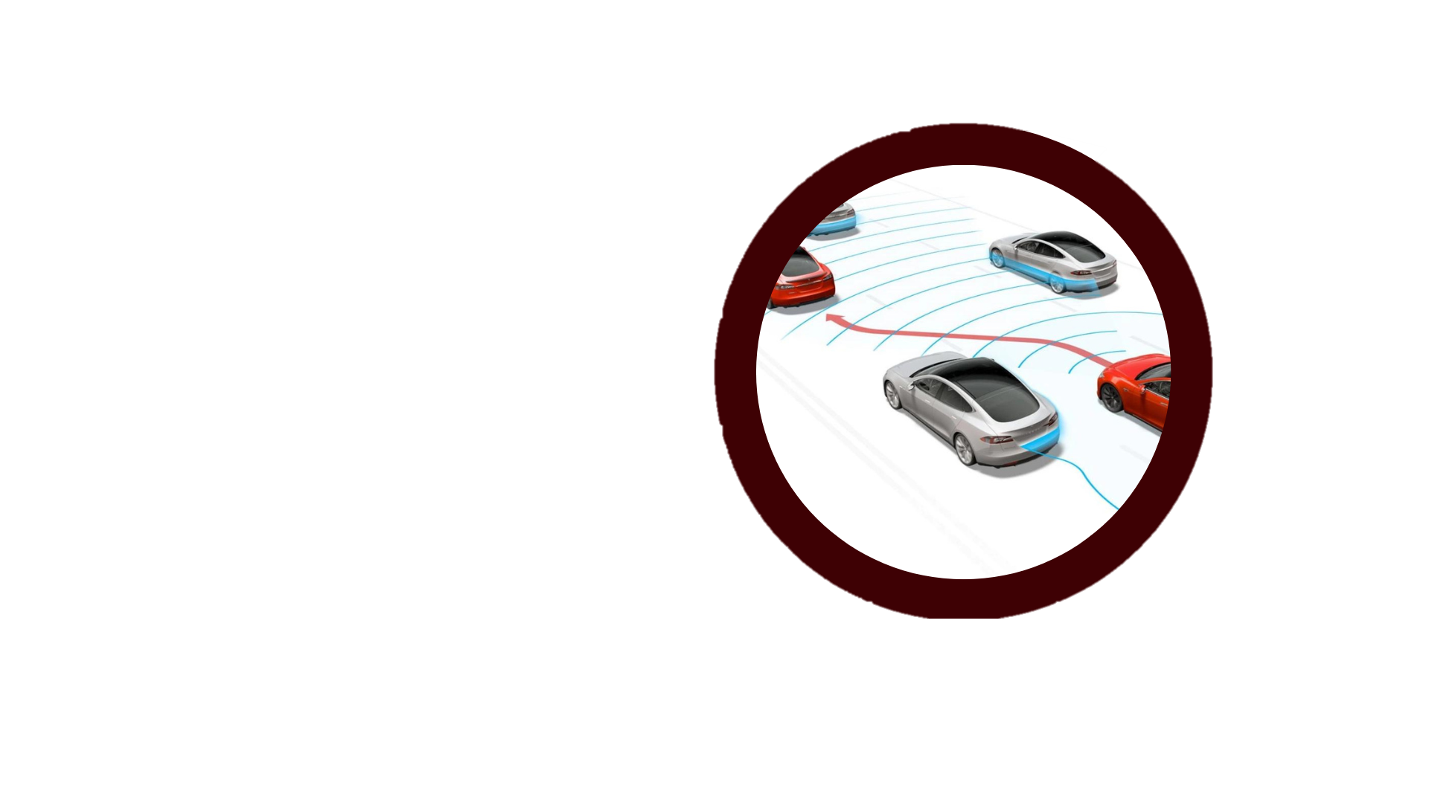
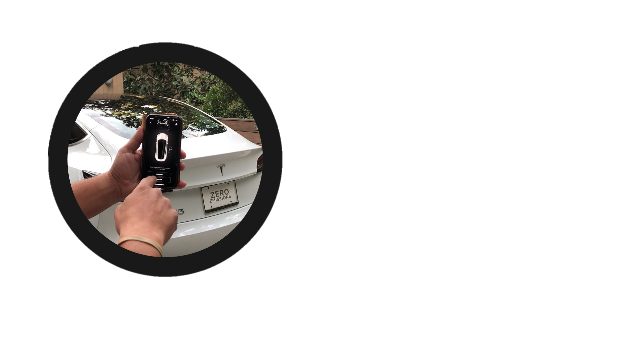
Tesla’s Autopilot Features
Traffic-Aware Cruise Control
Autosteer
Autopark
Auto Lane Change
Summon
Computer Vision
Object Detection
Sensor Fusion
Lane Detection
Path Planning
Control Systems
Space Detection
Path Planning
Object Avoidance
Surrounding Awareness
Risk Assessment
Execution
Obstacle Detection
Path Planning
Remote Control

Slide 8
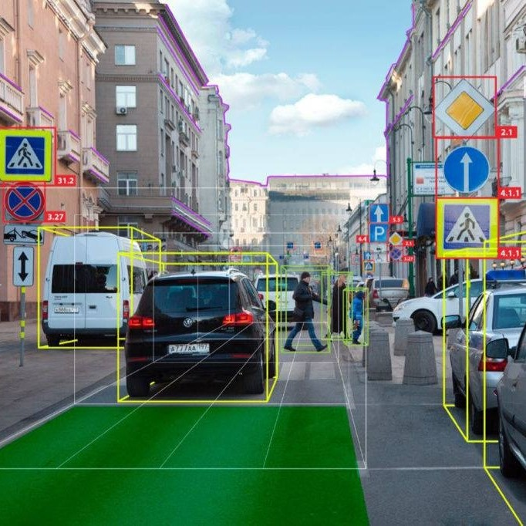
Traffic-Aware Cruise Control
1. Computer Vision
→ CNN sift through the camera footage, effectively recognizing and pinpointing lane lines and surrounding vehicles
2. Object Detection
→ Identifies various objects such as other vehicles, pedestrians, and road signs within the vehicle's surroundings.
3. Sensor Fusion
→ Radar sensors - estimate the distance of the vehicle ahead.
→ Ultrasonic sensors - provide short-range detection for objects very close to the car.
Notes:
A Convolutional Neural Network (CNN) is a type of deep learning algorithm

Slide 9
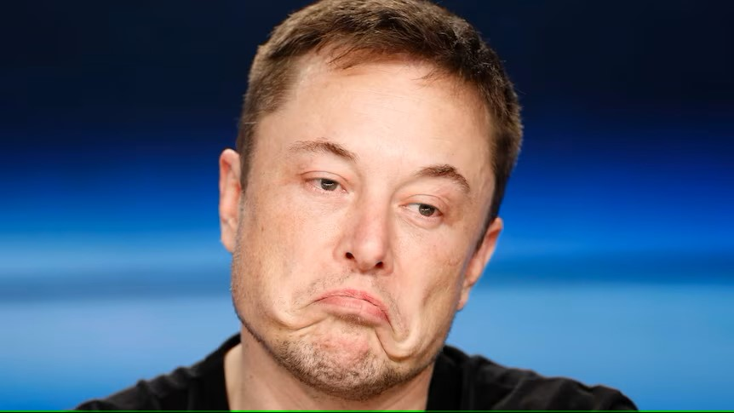
Challenges
Technical Challenges
Regulatory Challenges
Safety Challenges
Public Perception, Trust & Liability Challenges
Notes:
4.1 – Technical Challenges
4.1.1 - Sensor Integration and Accuracy
Case Example: In 2016, a Tesla Model S was involved in a fatal accident when Autopilot failed to recognize a white truck crossing the road against a bright sky background. The car's radar and camera sensors did not accurately detect the truck, highlighting the difficulties in sensor fusion and accuracy under challenging conditions4
4.2 – Regulatory Challenges
Tesla delayed the FSD Beta release in Canada pending approval from local regulatory bodies, showcasing the challenge of obtaining regulatory approval.
4.3 – Safety Challenges
4.3.2 - Balancing Autonomy and Human Control
Case Example: Numerous incidents have occurred where drivers were found not paying attention while Tesla's Autopilot was engaged, leading to accidents. For instance, in 2021, a Tesla Model 3 crashed into a police car while the driver was reportedly watching a movie, highlighting the challenge of balancing autonomy with the need for human oversight.
4.4 - Public Perception, Trust and Liability Issues
4.4.1 - Building Public Trust
Case Example: High-profile accidents involving Tesla's Autopilot, such as the 2018 fatal crash in Mountain View, California, have damaged public trust in the technology. These incidents have led to skepticism about the safety and reliability of autonomous driving, posing a significant challenge for Tesla in gaining public trust.

Slide 10
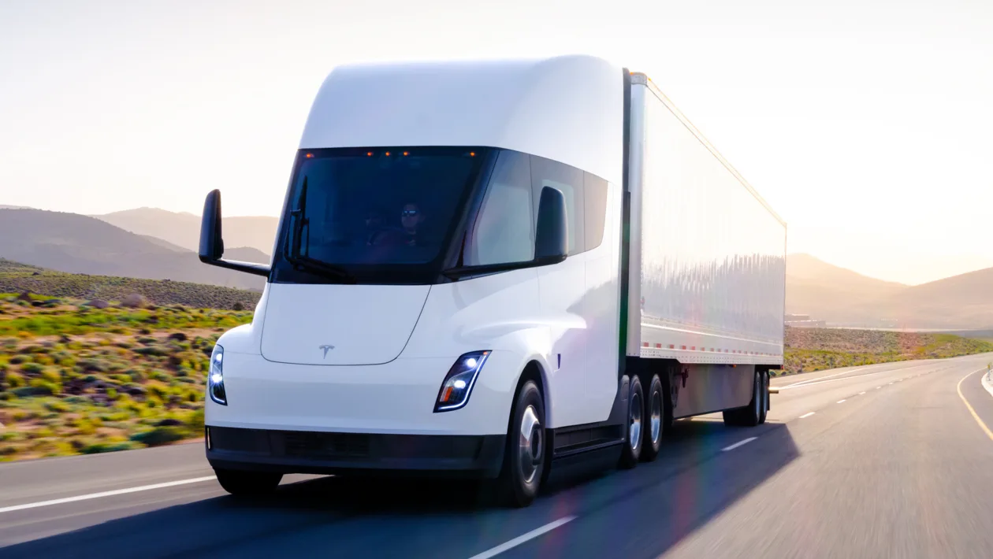
Conclusion
Future Directions of Tesla in 2025:
Expansion of Electric Vehicle (EV) Lineup
Battery Technology Advancements
Full Autonomous Driving
Energy Products
Global Expansion

